Slide 1
Registration and Segmentation with SITK
Giulia Crocioni
Netherlands eScience Center
18/09/2024

Slide 2
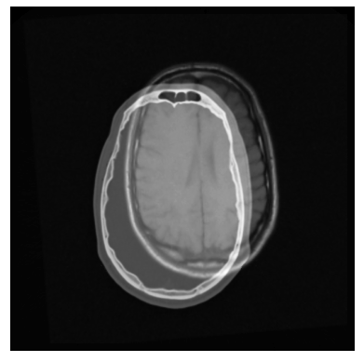
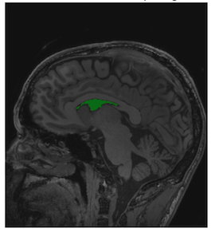

Registration and Segmentation with SITK
Example of two volumes superimposed that need to be registered to be aligned
Example of left lateral ventricle segmentation
SimpleITK (SITK) logo
https://github.com/SimpleITK/SimpleITK
Notes:
In the realm of medical imaging analysis, registration and segmentation play crucial roles. Registration aligns images, enabling the fusion of data or the tracking of changes over time. Segmentation identifies and labels objects of interest within images. Automation is essential due to high clinical demand, driving the development of robust algorithms for both processes. Moreover, many advanced segmentation techniques utilize image registration, whether implicitly or explicitly.
SimpleITK (SITK) is a simplified programming interface to the algorithms and data structures of the Insight Toolkit (ITK) for segmentation, registration and advanced image analysis, available in many programming languages (e.g., C++, Python, R, Java, C#, Lua, Ruby).
SITK is part of the Insight Software Consortium a non-profit educational consortium dedicated to promoting and maintaining open-source, freely available software for medical image analysis. Its copyright is held by NumFOCUS, and the software is distributed under the Apache License 2.0.
In this episode, we use a hands-on approach utilizing Python to show how to use SITK for performing registration and segmentation tasks in medical imaging use cases.

Slide 3
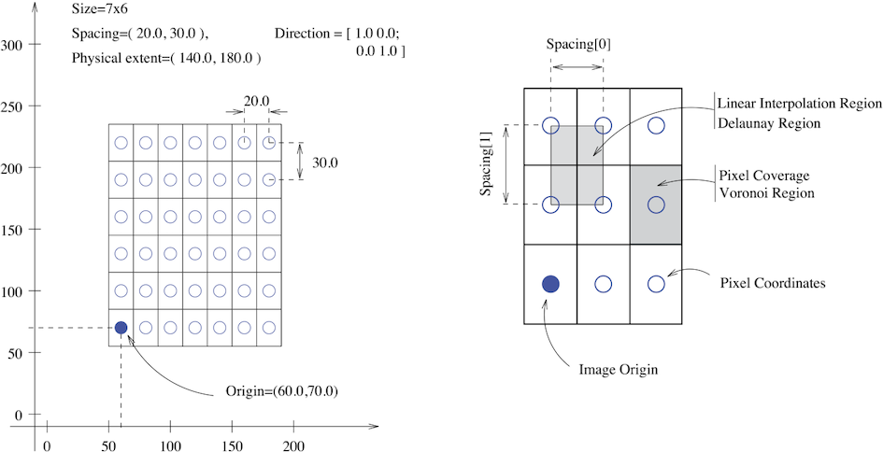
Fundamental Concepts - Images
Notes:
The fundamental tenet of an image in ITK and consequentially in SITK is that an image is defined by a set of points on a grid occupying a physical region in space . This significantly differs from many other image analysis libraries that treat an image as an array which has two implications: (1) pixel/voxel spacing is assumed to be isotropic and (2) there is no notion of an image’s location in physical space.
SITK images are multi-dimensional (the default configuration includes images from two dimensional up to five dimensional) and can be a scalar, labelmap (scalar with run length encoding), complex value or have an arbitrary number of scalar channels (also known as a vector image). The region in physical space which an image occupies is defined by the image’s:
Origin (vector like type) - location in the world coordinate system of the voxel with all zero indexes.
Spacing (vector like type) - distance between pixels along each of the dimensions.
Size (vector like type) - number of pixels in each dimension.
Direction cosine matrix (vector like type representing matrix in row major order) - direction of each of the axes corresponding to the matrix columns.
In SITK, when we construct an image we specify its dimensionality, size and pixel type, all other components are set to reasonable default values:
Origin - all zeros.
Spacing - all ones.
Direction - identity.
Intensities in all channels - all zero.

Slide 4
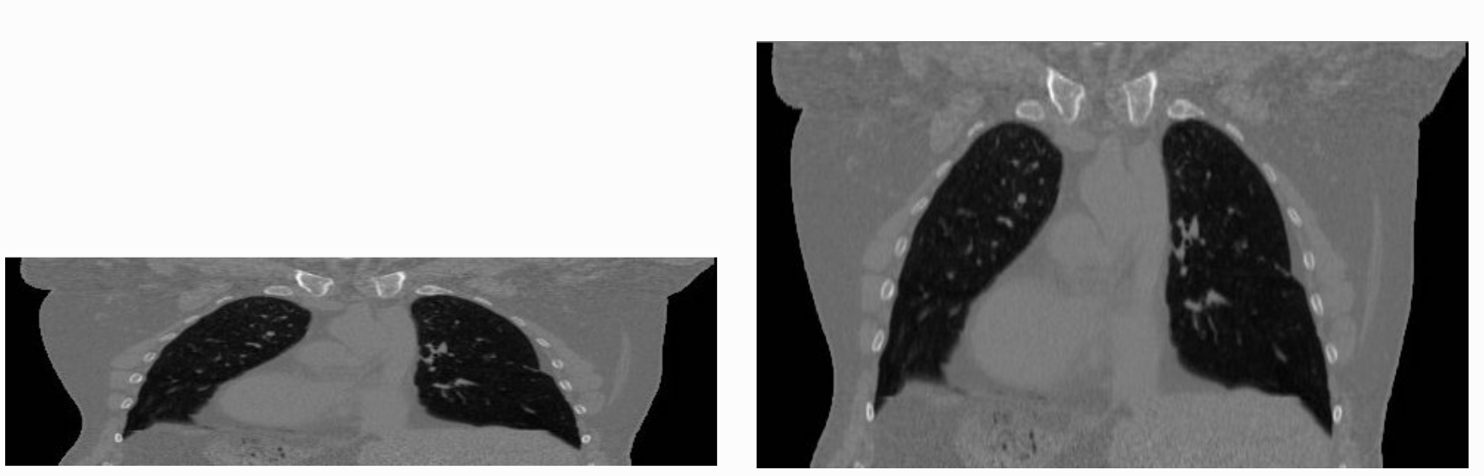
Fundamental Concepts - Images
Notes:
The tenet that images occupy a spatial location in the physical world has to do with the original application domain of ITK and SITK, medical imaging. In that domain images represent anatomical structures with metric sizes and spatial locations. Additionally, the spacing between voxels is often non-isotropic (most commonly the spacing along the inferior-superior/foot-to-head direction is larger). Viewers that treat images as an array will display a distorted image as shown on the right.
The same image displayed with a viewer that is not aware of spatial meta-data (left image) and one that is aware (right image). The image’s pixel spacing is (0.97656, 2.0)mm.

Slide 5
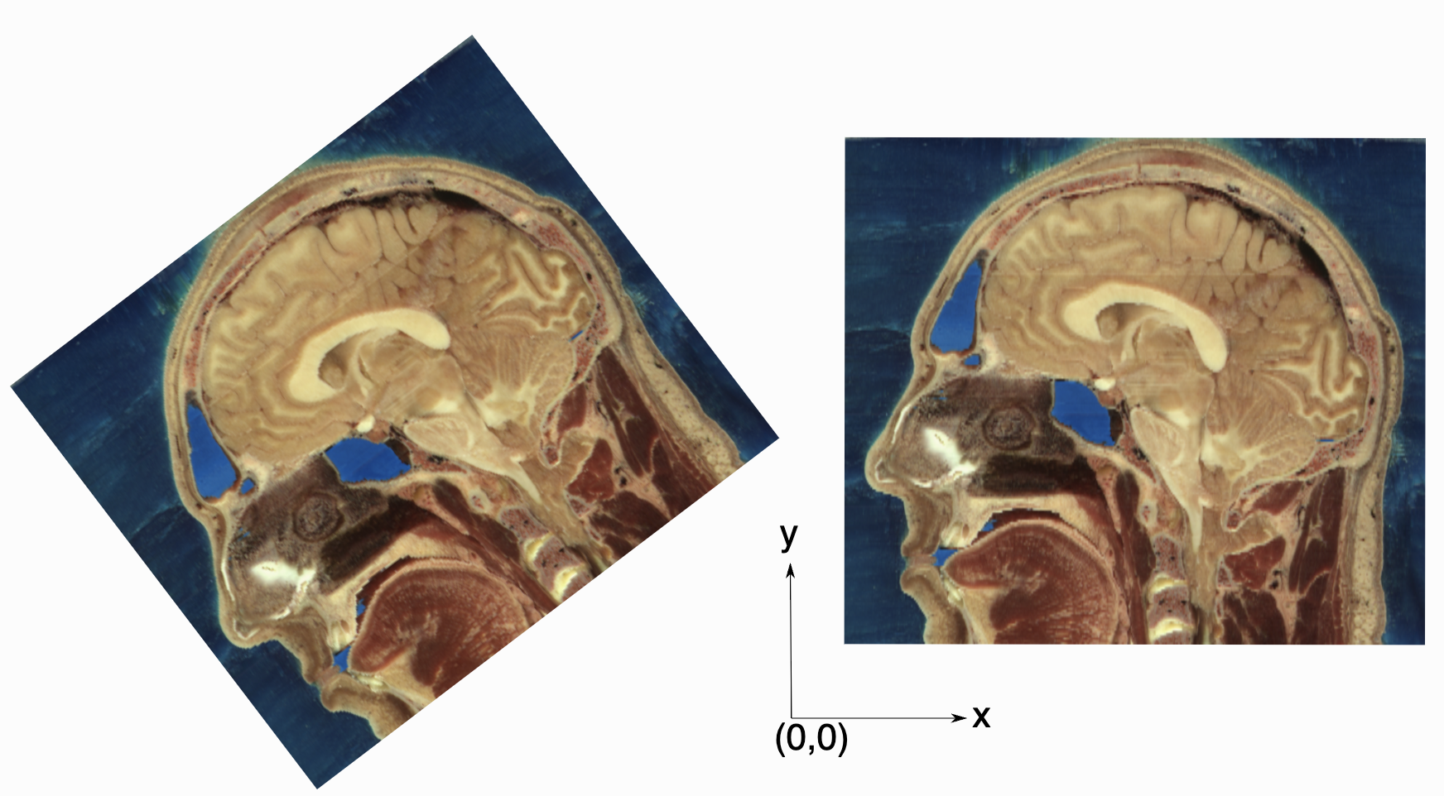
Fundamental Concepts - Images
Notes:
As an image is also defined by its spatial location, two images with the same pixel data and spacing may not be considered equivalent. Think of two CT scans of the same patient acquired at different sites. The following figure illustrates the notion of spatial location in the physical world, the two images are considered different even though the intensity values and pixel spacing are the same.
Two images with exactly the same pixel data, positioned in the world coordinate system. In SITK these are not considered the same image, because they occupy different spatial locations.
As SITK images occupy a physical region in space, the quantities defining this region have metric units (cm, mm, etc.). In general SITK assumes units are in millimeters (historical reasons, due to DICOM standard). In practice SITK is not aware of the specific units associated with each image, it just assumes that they are consistent. Thus, it is up to you the developer to ensure that all of the images you read and created are using the same units.
A SITK image can have an arbitrary number of channels with the content of the channels being a scalar or complex value. This is determined when an image is created.

Slide 6
Fundamental Concepts – Transforms
Global domain transforms
Translation, rotation, similarity, affine, etc.
𝑇(𝑥)=𝐴(𝑥−𝑐)+𝑡+𝑐
Bounded domain transformations
Identity outside the domain
B-spline, displacement field, etc.
Composite transformation
𝑇0(𝑇1(𝑇2(...𝑇𝑛(𝑝))))
Notes:
Types of Spatial Transforms in SITK:
Global Domain Transforms:
These apply to the entire space.
Points are transformed using the formula: 𝑇(𝑥)=𝐴(𝑥−𝑐)+𝑡+𝑐, where:
Matrix (A): Describes how points are rotated or scaled.
Center (c): The point around which transformations happen.
Translation (t): The shift applied after rotation/scaling.
Offset (t+c−Ac): Represents the combined effect of translation and center shift.
Types include translation, rotation, rigid, similarity, and affine transformations, which are useful for image registration.
Bounded Domain Transforms:
Only affect a specific region in space; outside this region, no transformation occurs (identity).
Examples:
B-spline Deformable Transformation (Free-Form Deformation): Uses a grid of control points to create smooth transformations in the region.
Displacement Field Transformation: Uses a dense set of vectors to move points within the region, without needing to be smooth.
Composite Transformations:
You can combine multiple transformations (both global and bounded) and apply them one after the other, stacking their effects.

Slide 7
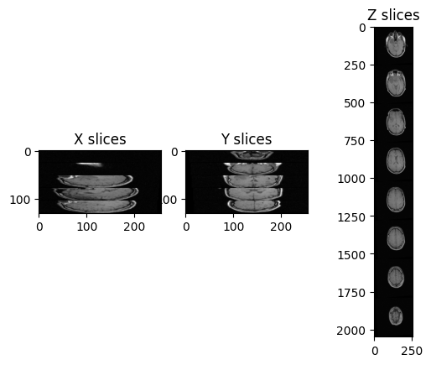
Fundamental Concepts – Resampling
Image
Coordinate system m
Resampling grid
A grid of points in a different coordinate system f
Transformation
It maps points from the resampling grid (f) to the image’s coordinate system (m)
Interpolator
sitkLinear
sitkNearestNeighbor
Notes:
What is Resampling?
Resampling means "sampling again"—in this case, reprocessing an image, which itself is a sample of a continuous signal.
Key Components:
Image: The image you are resampling (from coordinate system mmm).
Resampling Grid: A grid of points in a different coordinate system fff, which will be mapped back to mmm.
Transformation (TmfT_{mf}Tmf​): This maps points from the resampling grid (fff) to the image's coordinate system (mmm).
Interpolator: The method used to calculate intensity values at new points.
Common options:
sitkLinear: The most used, balancing accuracy and speed.
sitkNearestNeighbor: Used for labeled/segmented images to prevent introducing new labels.
Specifying the Resampling Grid:
You can choose the grid in three ways:
Use the same grid as the image being resampled.
Use a reference image to define the grid.
Manually define the grid using size, origin, spacing, and direction matrix.
Important Notes:
Points outside the image's spatial extent are assigned a default value (usually zero).
An empty (black) image may result from:
Incorrect resampling grid settings (rare but possible).
Using the inverse transformation by mistake—this is common but can be fixed by using the GetInverse method.
In this case, there are only 26 images in the volume and the spacing between voxels is non-isotropic, and in particular it is the same across x- and y-axis, but it differs across the z-axis.
We can fix the distortion by resampling the volume along the z-axis, which has a different spacing (i.e., 4mm), and make it match with the other two spacing measures (i.e., 1.25mm)

Slide 8
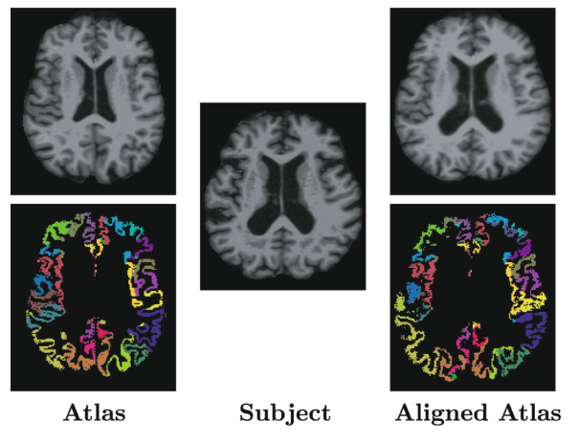
Registration
Fig. 1 in Chen M, Tustison NJ, Jena R, et al., “Image Registration: Fundamentals and Recent Advances Based on Deep Learning”. 2023 Jul 23. In: Colliot O, editor. Machine Learning for Brain Disorders [Internet]. New York, NY: Humana; 2023. Chapter 14. Available from: https://www.ncbi.nlm.nih.gov/books/NBK597490/ doi: 10.1007/978-1-0716-3195-9_14
Notes:
Image registration involves spatially transforming the source/moving image(s) to align with the target image. More specifically, the goal of registration is to estimate the transformation which maps points from one image to the corresponding points in another image. The transformation estimated via registration is said to map points from the fixed image (target image) coordinate system to the moving image (source image) coordinate system.
Shown is an example of an atlas alignment using image registration between two different brain magnetic resonance images. The atlas image (top left) is transformed (top right) to be aligned with the fixed subject image (center). The transformation allows the anatomical labels from the atlas (bottom left) to be directly transferred (bottom right) to label the subject image.
SITK provides robust registration capabilities and allows you to code your own registration algorithms.

Slide 9
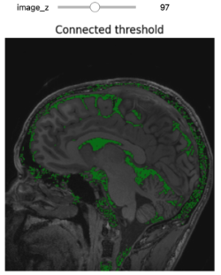
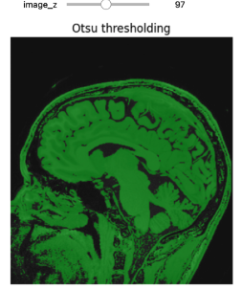
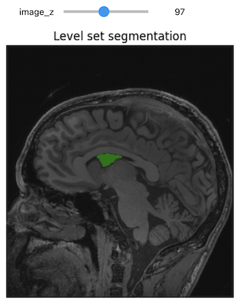
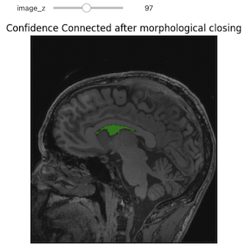
Segmentation
Notes:
Image segmentation filters process images by dividing them into meaningful regions. SITK provides a wide range of filters to support classical segmentation algorithms, including various thresholding methods and watershed algorithms. The output is typically an image where different integers represent distinct objects, with 0 often used for the background and 1 (or sometimes 255) for foreground objects. After segmenting the data, SITK allows for efficient post-processing, such as labeling distinct objects and analyzing their shapes.
Thresholding is the most basic form of segmentation. It simply labels the pixels of an image based on the intensity range without respect to geometry or connectivity.
- Region Growing Segmentation. The first step of improvement upon the naive thresholding is a class of algorithms called region growing. The common theme for all these algorithms is that a voxel’s neighbor is considered to be in the same class if its intensities are similar to the current voxel.

Slide 10


Thank you!
“Empowering
researchers across
all disciplines
through innovative
research software”
Hands-on time
Giulia Crocioni
Research Software Engineer
www.esciencecenter.nl
g.crocioni@esciencecenter.nl

